Slide 1

18ECE340T- MACHINE PERCEPTION WITH COGNITION
UNIT-3
Session-2
Topics Covered: Extracting image Structure with filter bank
Reference Book
Computer and Machine Vision by E.R.Davies
Prepared by
Dr. C.VIMALA
Assistant Professor/ ECE

Slide 2
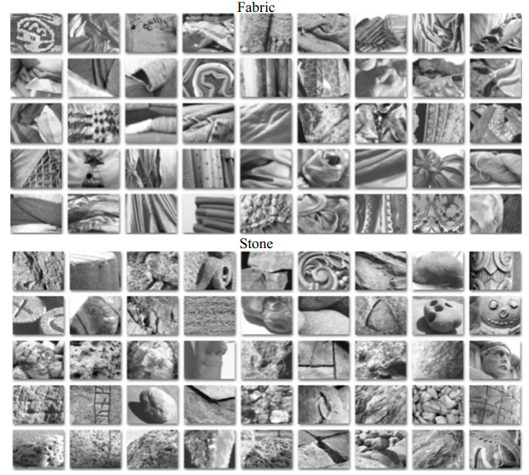
Local texture representations
Image textures generally consist of repeated elements. An element is sometimes called a texton.
For example, some of the fabric textures in Figure consist of triangles of wool formed by the knit pattern.
Similarly, some stone textures in that figure consist of numerous, near-circular, gray blobs.
It is natural to represent a texture with some description of (a) what the textons are and (b) how they repeat

Slide 3
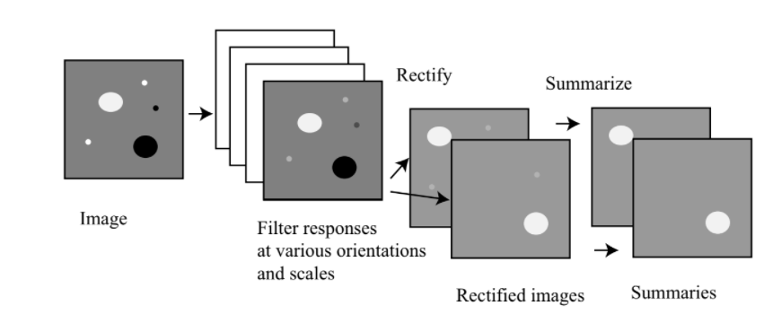
Local texture representations --- filtering
Local texture representations can be obtained by filtering an image with a set of filters at various scales.

Slide 4
It is difficult to be precise about what a texton is, because if a large pattern repeats frequently, then so do its parts.
This presents no major problems---because not need to extract textons accurately.
Need to representations that differ in ways that are easy to observe when two textures are significantly different.
This is achieved by assuming that all textons are made of generic sub elements, such as spots and bars.
If sub elements with filters, then represent each point in the image with a summary of the pattern of sub elements.
This will work because the parts of a texton repeat in the same way .

Slide 5
Textures from filter output
Representing image textures in terms of the response of a collection of filters.
Each filter is a detector for a sub element.
The collection of different filters would represent sub elements spots and bars are usual at a collection of scales (to identify bigger or smaller sub elements).
Represent each point in an image by the vector of filter outputs at that point.
This vector gives a sense of how much the neighborhood around that point looks like each sub element.

Slide 6
Spots and Bars
By analogy with the human visual cortex---different filter can be used.
spot filters
oriented edge filters,
oriented bar filters at different orientations and scales
This kind of filter is like a natural choice, because these are in some sense “minimal” sub elements.
It would be hard to have sub elements of patterns with less structure than a spot, and it would be hard to have oriented sub elements with less structure than an edge.

Slide 7
In texture recognition performance to be unaffected if the texture sample is rotated.
This is difficult to achieve with oriented filters, because one might need to sample the orientations very finely.
An alternative to using oriented filters is to use filters that are orientation-independent, all of which must look like complicated spots

Slide 8
From Filter Outputs to Texture Representation
Assume an image I. A set of filter output maps (which would have the form Fi ∗ ∗I for different filters Fi) is not, in itself, a representation of texture.
The representation tells ---- window around a pixel looks like; but in a texture, The counts is not only at a pixel, but also it is near by pixel.
Example, a field of yellow flowers may consist of many small yellow spots with some vertical green bars.
What’s important is not just the fact that a particular pixel looks a lot like a spot, but also that near the pixel there are no other spots, but some bars. This means the texture representation at a point should involve some kind of
summary of nearby filter outputs, rather than just the filter outputs themselves.

Slide 9
A neighborhood around a pixel that is rather bigger than the scale of the filter.
To know whether the neighborhood around a pixel is “spotty,” it is not enough to know that there is one strong spot in it; there should be many spots, each quite small compared to the size of the patch.
However, it is important not to look at too large a neighborhood, or else the representation will not change much as we move across the image (because the neighborhoods overlap).
The particular arrangement of these spots within a neighborhood doesn’t matter all that much,because the patch is small.

Slide 10
For example, a light spot filter will give a positive response to a light spot on a dark background, and a negative response to a dark spot on a light background.
As a result, if simply average filter responses over a patch, then a patch containing dark and light spots might record the same near-zero average as a patch containing no spots.

Slide 11
compute the absolute value for each output map
Ccompute the absolute value for each output map, to get |Fi ∗ ∗I |.
This does not distinguish between light spots on a dark background and dark spots on a light background.
An alternative, which does preserve this distinction, is to report both max(0, Fi∗∗I(x, y)) and max(0, −Fi∗∗I(x, y)) (this is half-wave rectification), which yields two maps per filter.
Around a pixel by computing a Gaussian weighted average (equivalently, convolving with a Gaussian).
The scale of this Gaussian depends on the scale of the filter for
the map; typically, it is around twice the scale of the filter.

Slide 12
The Leung-Malik (LM) Filter Bank
consider two versions of the LM filter bank. In LM Small (LMS), LM Large (LML) the filters occur at basic scales .
In LM Small (LMS), the filters occur at basic scales
The first and second derivative filters occur at the first three scales with an elongation factor of 3 .
The Gaussians occur at the four basic scales while the 8 LOG filters occur at and . For LM Large (LML), the filt ers occur at the basic scales .

Slide 13
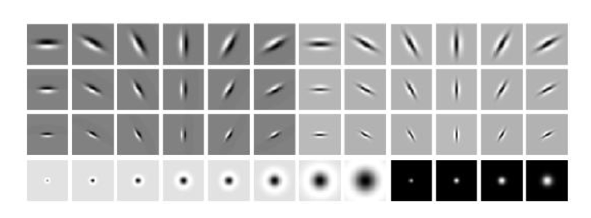
LM filter bank
The LM filter bank has a mix of edge, bar and spot filters at multiple scales and orientations.
It has a total of 48 filters
2 Gaussian derivative filters at 6 orientations and 3 scales,
8 Laplacian of Gaussian filters and 4 Gaussian filters.
(2*(6*3))+8+4=48

Slide 14
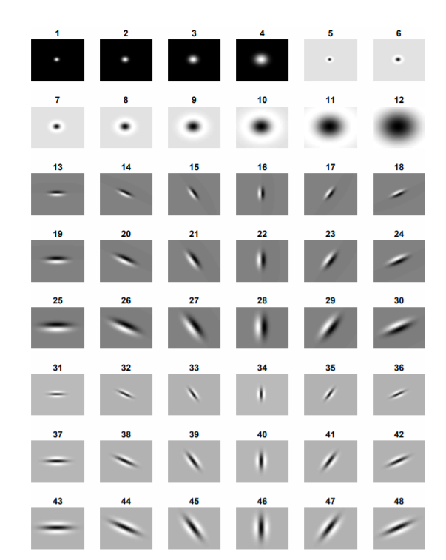
Filters 1-4: Gaussian function (low-pass filter) at four different scales (sigmas).
Filters 5-12: a blob filter - a LoG in this case - at eight different scales.
Filters 13-30 (rows 3, 4 and 5): an edge filter - first derivative of the Gaussian in this case - for six different orientations and three different scales.
Filter 31-48 (bottom three rows): a bar filter - generated analogously to the edge filter.

Slide 15
Algorithm--- Local filtering for texture.
Input : image I, set of n filters Fi (see Figure 20) (i = 1..10) Parameters : radius for suppression in maximum search 1)
(1) Apply each filter Fi to the image to obtain a response map Ri = I ∗ Fi
(2) Rectification: for each Ri compute max(0, Ri) and min(0, −Ri), resulting in 2n maps Rj (j = 1..2n)
(3) For each Rj , compute local summaries Rs j by either
(a) convolving with a Gaussian of scale approximately twice the scale of the base filter
(b) taking the maximum value over a certain radius r.
(4) Locate the maxima (in each map?) using an inhibition-of-return mechanism:l = 1..nmax with coordinates [xl , yl ]
Output : set of ’hot spot’ vectors xl(j) whose components j correspond to the filter response Rj at location (xl , yl)

Slide 16
Bandpass Filtering
Regions (Blobs, Dots) with Bandpass Filtering Many regions are often either darker or brighter in comparison to their surround.
One way to identify them would be by applying a threshold to the intensity values.
That would be a technique that works well if the image consist of a homogenous background and foreground objects that stand out clearly from the background;
To use a technique that is slightly more flexible, but also more complicated.

Slide 17
In which case positive values correspond to brighter regions, and negative values correspond to darker regions.
where those differences are taken between levels of the scale space.
As the fine and coarse image correspond to low-pass filtered images, their subtraction corresponds to the process of band-pass filtering.
During band-pass filtering a certain center range (’band’) of values is selected, as opposed to the low-pass filtering, for which a lower range of values is selected.

Slide 18
structural patterns
Texture is observed in the structural patterns of object surfaces such as wood, grain, sand, grass, and cloth.
But even scenes, that consist of many objects, can be regarded as texture.
The term texture generally refers to the repetition of basic texture elements called textons (or texels in older literature).
Natural textures are generally random, whereas artificial textures are often deterministic or periodic.
Texture may be coarse, fine, smooth, granulated, rippled, regular, irregular, or linear.

Slide 19
One can divide texture-analysis methods into four broad categories:
Statistical: these methods are based on describing the statistics of individual pixel intensity values.
Structural: in structural analysis, primitives are identified first, such as circles or squares, which then are grouped into more ’global’ symmetries.
Avoid that approach in favor of better performing approaches.

Slide 20
Spectral: The image is firstly filtered with a variety of filters such as blob and orientation filters, followed by a statistical description of the filtered output.
Caution: these methods are sometimes also called ’structural’.
Local Binary Patterns: Turns statistical information into a code.

